Slide 1
Plannor App
CMP309 – Android Mobile Application | Moustapha Diaby
2001890

Slide 2

What Does the App Solve?
As a contractor, I want an easy way to track and manage the times that I work for each of my contractors.
I want to be able to easily track the hours worked and my expected pay.

Slide 3
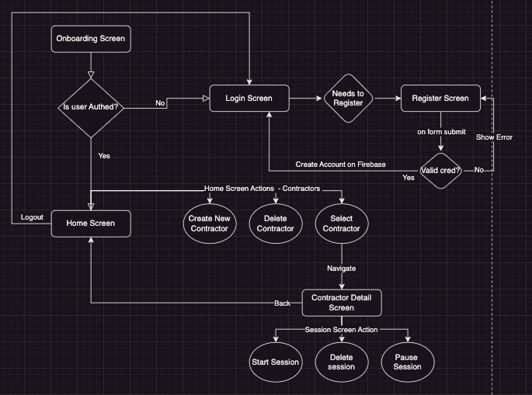
App Screen Flow and Actions

Slide 4

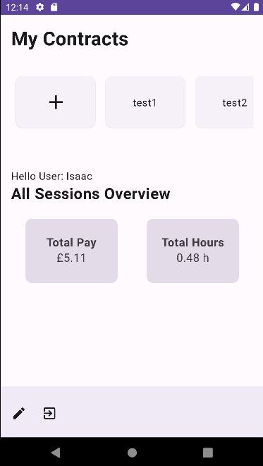
How Is The App Built?
Overview – Tech Stack

Slide 5
Fundamentals
Kotlin (personal preference)
Firebase – Authentication, Firestore (Non-Relational Database)
Compatibility and Scalability
Uses internet access permission – INTERNET, ACCESS_NETWORK_STATE
Authentication
allowed the user to log in with email, password
Firestore
Account information
Contactor
Sessions

Slide 6
Jetpack Compose
Jetpack Compose – UI Component and Design Library
Used Material Design and best UI Design best practices
Allows me to quickly develop UI
Navigation
ViewModel - State Management - Stores UI State + Business Logic
UserViewModel
ContractsViewModel
ContractSessionViewModel

Slide 7
Notification and Services
Notifications
When the timer is started the user can close the app and still be able to see the timer counting up.
Bound Service
Manages the state stopwatch and the notification
Timer Bindings to the UI and the notification
Doesn’t perform any database called as that is why we have the view model

Slide 8

How Is The App Built? Part 2
Demo + Code

Slide 9
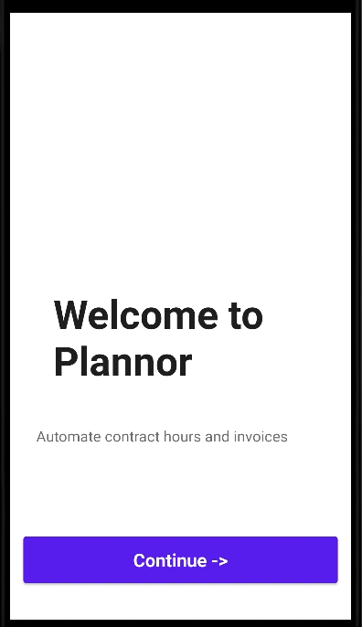
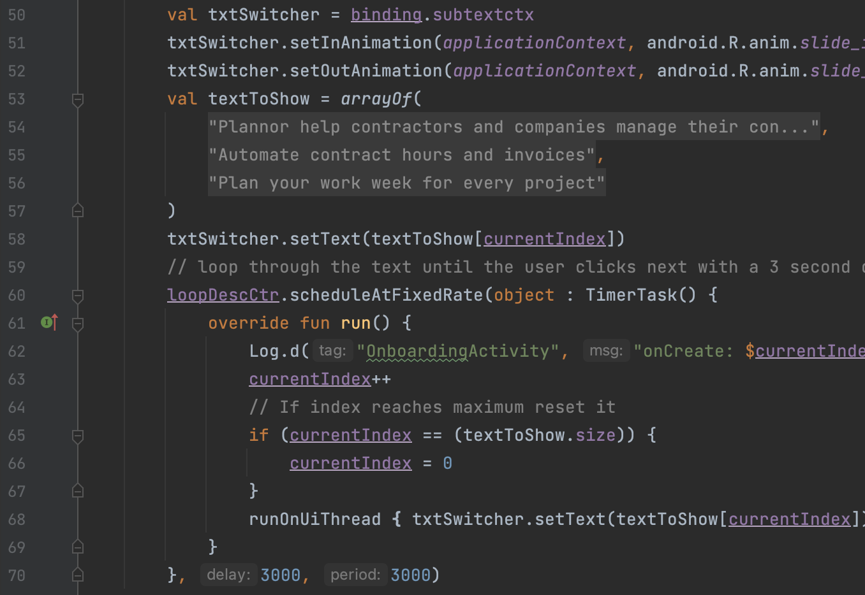
Onboarding Screen
Uses XML with the ConstraintLayout - onboarding_main.xml
Continue button goes to the login screen OnboardingActivity.kt:40
Uses an animated TextSwitcher to automatically Scroll over the onboarding messages. OnboardingActivity.kt:60
If the user is already authenticated, they will navigate directly to the main activity

Slide 10
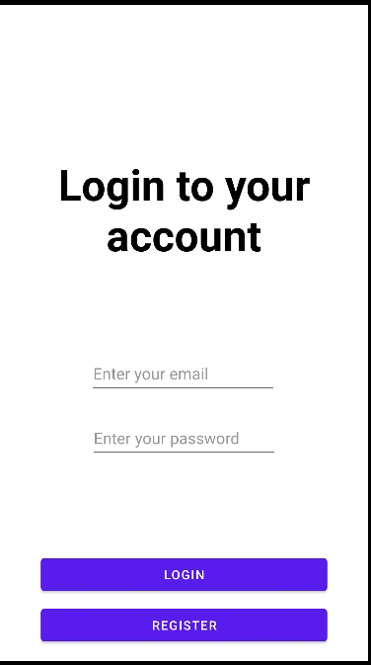
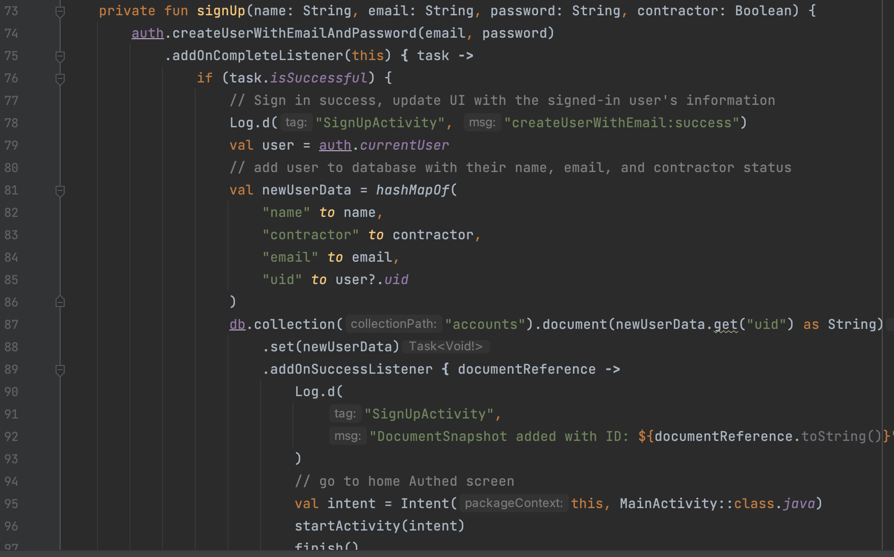
Registration Screen
Before a user can log in they must register an account
We Check that the input is valid!
AuthHelper.kt:5
This is saved by using FireStore.
SignUpActivity.kt:73

Slide 11
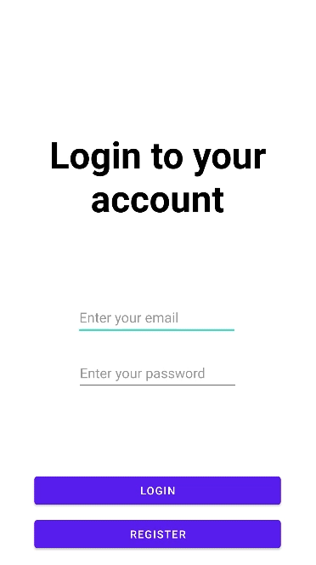
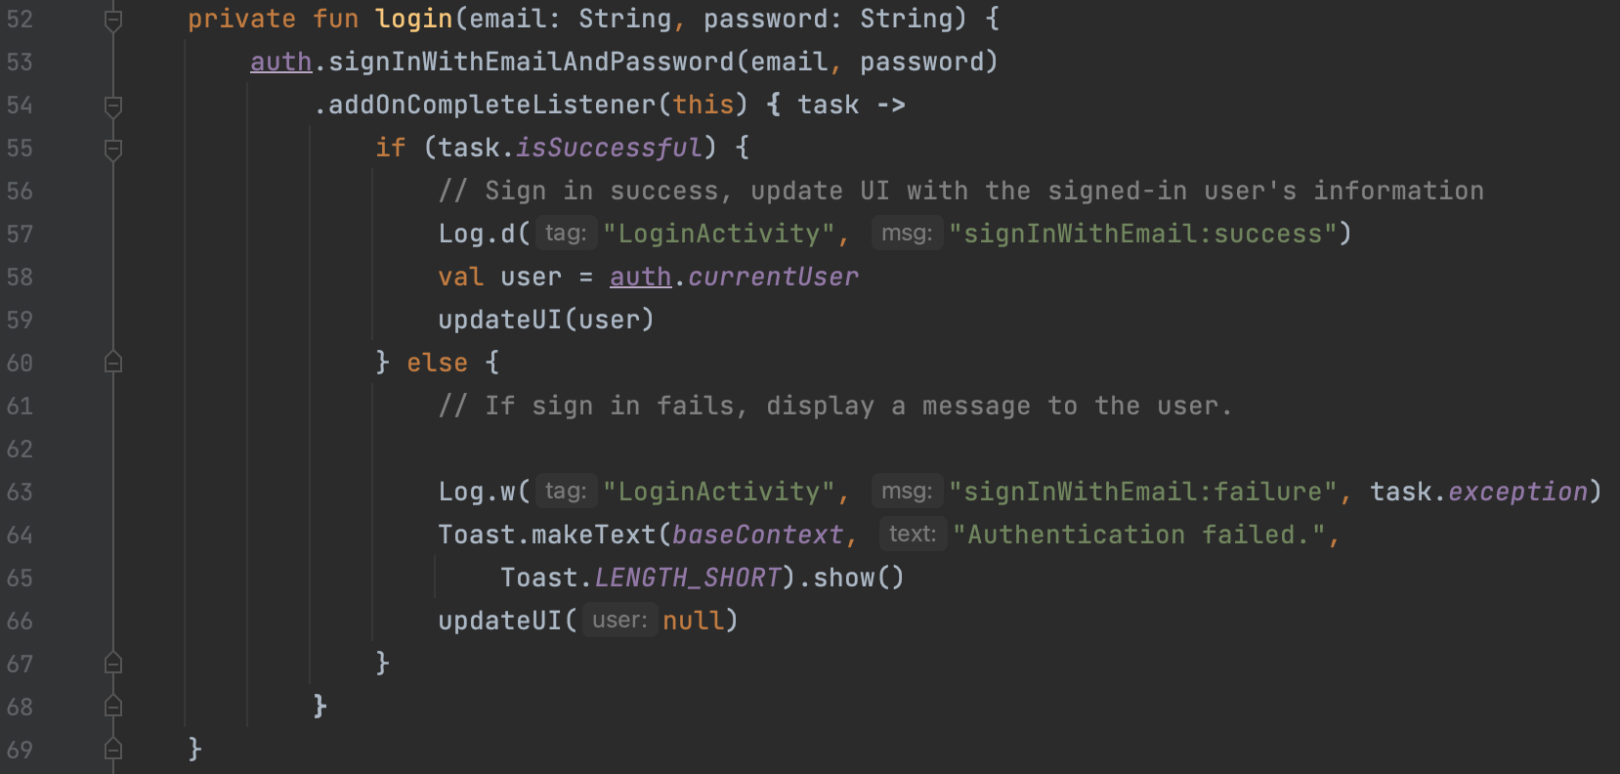
Login Screen
When a user has an account registered they can login with their email and password
LoginActivity.kt:52
We also perform user input checks (valid email and password) before allowing the user to go to the

Slide 12
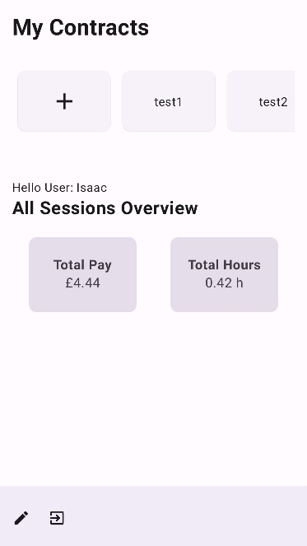
Home Screen
Used Jetpack Compose
HomeScreen.kt
Uses The Compose Navigator
navRouter.kt
Which houses all of the view models and shares the same instance with all routed Screens
What can you Do on this Screen?
Create a new Contractor
Select a Contractor to navigate to the Contractor detail Screen
Enter edit mode and Delete a contractor
Log out

Slide 13
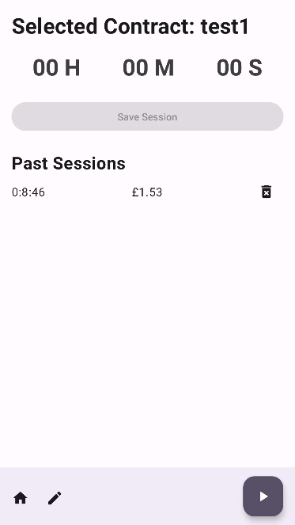
Contractor detail Screen
Used Jetpack Compose
ContractorScreen.kt
Uses The Compose Navigator
navRouter.kt
What can you Do on this Screen?
Create a new Contractor session
Delete a contractor session
Navigate back to the home screen

Slide 14
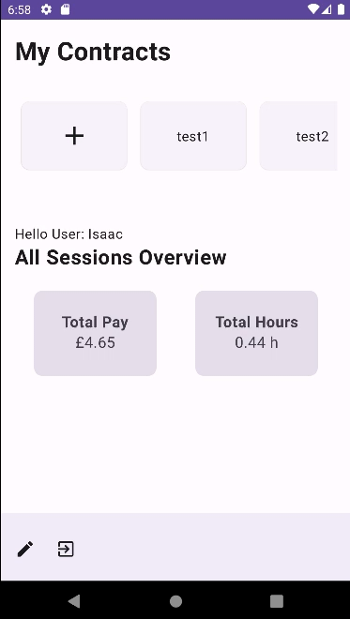
Notification and Services
Make use of a bound Service which allows us to tie the service to an activity and fully manage its instance.
Was used to create the notification, edit the state with intent actions and stream the timer information bidirectional to the notification and the application
Allowed us to keep the timer running even when the application is closed or in the background.

Slide 15
Future Work
Authentication
Other Auth Providers – Google, Facebook, Github
Firebase Handles them but needs to integrate and enable it.
Contractor
Edit The Hourly Rate – right now it's fixed to £10.50
Share Your Sessions with Other Contractor Users
Users
Be able to add other users and see when they are online with the Realtime database from Firebase.

Slide 16

Thanks For Listening

Slide 17
References
https://developer.android.com/codelabs/basic-android-kotlin-compose-viewmodel-and-state#4 – Basic Android Kotlin Compose ViewModel and State, by Google, accessed 2 May 2023
https://developer.android.com/guide/components/bound-services - Bound Services, , by Google, accessed 8 May 2023
https://youtu.be/4gUeyNkGE3g - Jetpack Compose Navigation for Beginners - Android Studio Tutorial Youtube video, by Philipp Lackner, accessed 3 May 2023
https://youtu.be/goFpG25uoc8 - Type safe, multi-module best practices with Navigation Compose Youtube video, by Google, accessed 5 May 2023
https://developer.android.com/guide/navigation/navigation-type-safety - navigation type safety Youtube video, by Google, accessed 5 May 2023
https://github.com/stevdza-san/Stopwatch-Android-App - reference for stopwatch lib, by stevdza-san on GitHub, accessed 8 May 2023
https://developer.android.com/training/dependency-injection/hilt-android - Dependency injection with Hilt, , by Google, accessed 10 May 2023

